Slide 1
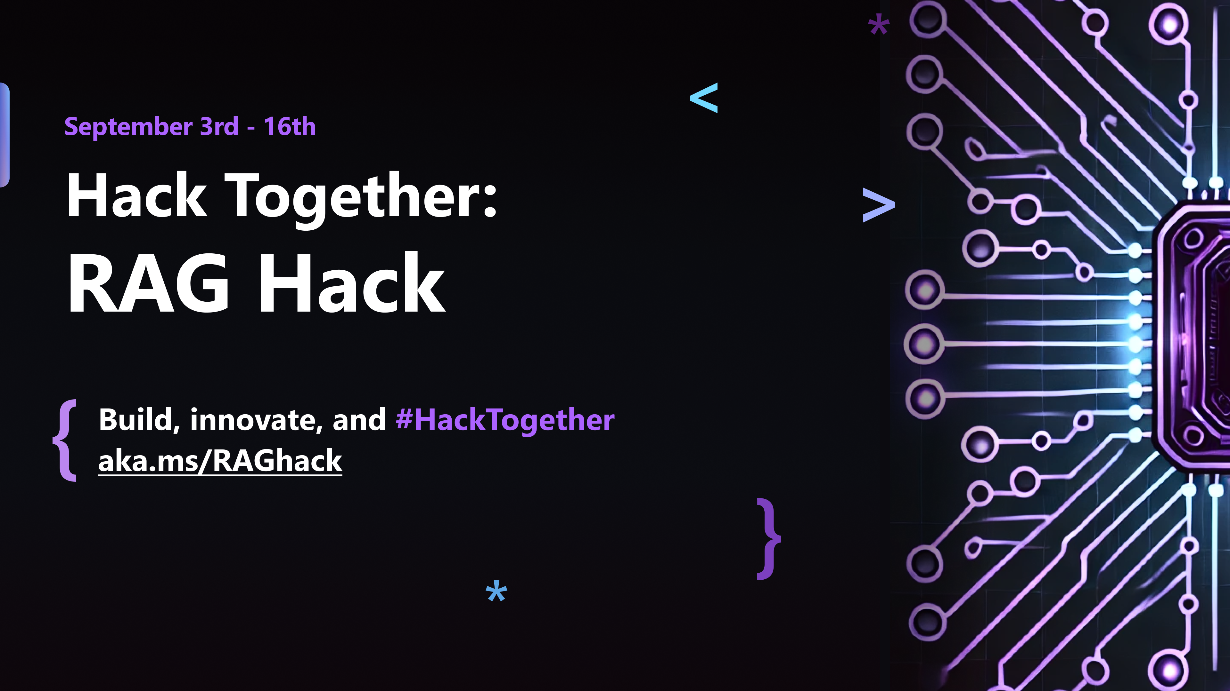

Slide 2
Building RAG apps with LangChain.js
Glaucia Lemos
Yohan Lasorsa

Slide 3
Agenda
Serverless AI chatbot
RAG: Retrieval Augmented Generation
LangChain.js
Deep dive in the sample

Slide 4
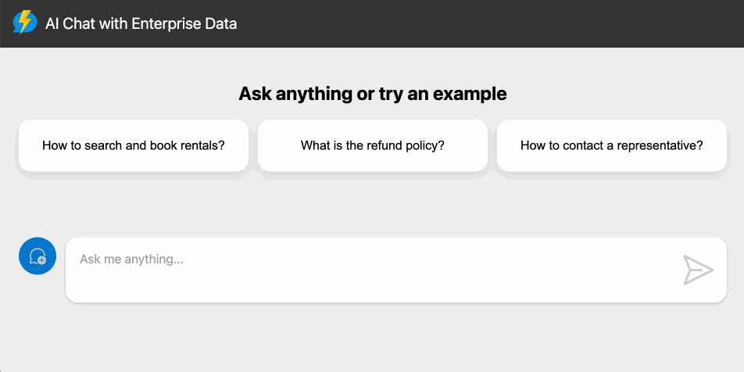
👉 aka.ms/ai/js/chat 👈

Slide 5
Why this sample?
Full-stack TypeScript
Cheap: uses serverless & free tiers
Use your own data
Works fully locally with Ollama
Simplest end-to-end sample

Slide 6
Known AI challenges
Wrong or inaccurate information
Out of date data
Non-authoritative sources

Slide 7
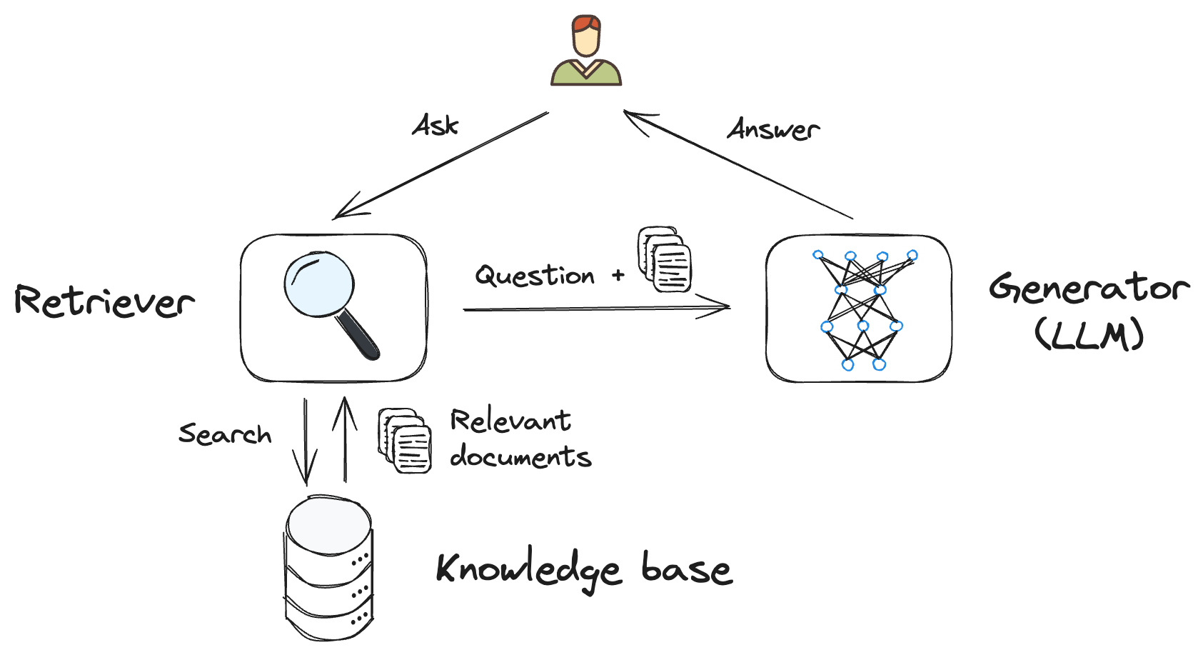
Retrieval-Augmented Generation (RAG)
Combination of a retriever and a generator
Allows for more precise and relevant answers

Slide 8
Why RAG?
No training needed
Up-to-date data
Groundedness
User trust

Slide 9
Retrieval-Augmented Generation (RAG)

Slide 10
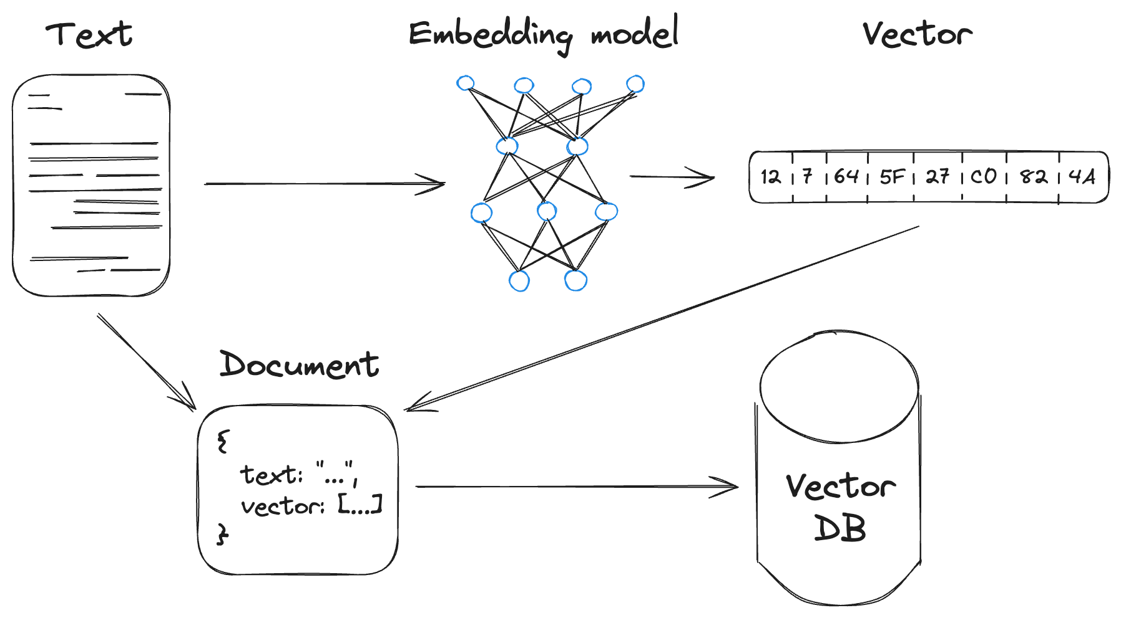
Building the knowledgebase
Create document embeddings from text data to use in the retriever

Slide 11
Building the knowledgebase

Slide 12
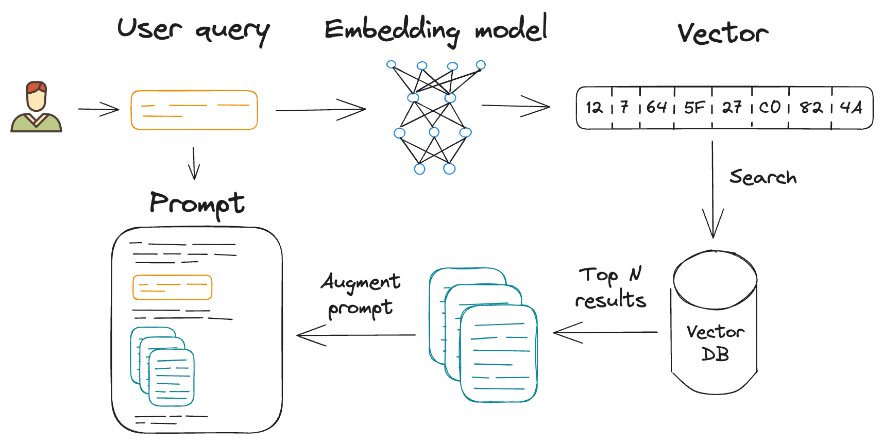
Retrieval and context augmentation
Transform the user query into a vector
Search in vector DB for relevant documents
Add found documents to the context

Slide 13
Retrieval and context augmentation
Transform the user query into a vector

Slide 14
Retrieval and context augmentation
Search in vector DB for relevant documents

Slide 15
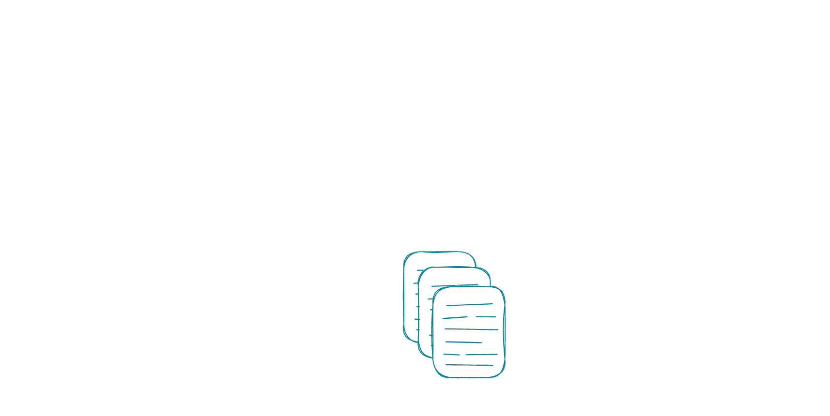
Retrieval and context augmentation
Add found documents to the context

Slide 16
LangChain.js
Open-source JavaScript library for working with LLMs
Provides high-level abstractions
models, vector databases, agents…
Bridge between local and cloud-based components
Allows complex compositions of models and data

Slide 17
Prompt templates
Inject user input, parameters and context into prompts
main.js
const promptTemplate = ChatPromptTemplate.fromMessages([
["system", "You are a helpful assistant"],
["user", "Tell me a joke about {topic}"],
]);
await promptTemplate.invoke({ topic: "cats" });

Slide 18
Runnable and chains
Compose processing sequences
main.js
type Joke = { joke: string };
const model = new ChatOpenAI({ model: "gpt-4o-mini" });
const prompt = ChatPromptTemplate.fromTemplate(
"Tell a joke about {topic}. Answer with valid JSON, containing one field: 'joke’”);
const parser = new JsonOutputParser<Joke>();
const chain = prompt
.pipe(model)
.pipe(parser);
await chain.invoke({ topic: "bears" });

Slide 19
Components overview
Component | Usage
Chat models | AI chat completions
Embedding models | Transform text into vectors
Document loaders | Load text from various document formats
Document transformers | Process documents (chunking, tagging…)
Vector stores | Store documents and perform vector search
Store | Store chat history
Retrievers | Get documents
Tools | Functions that can be called by agents

Slide 20
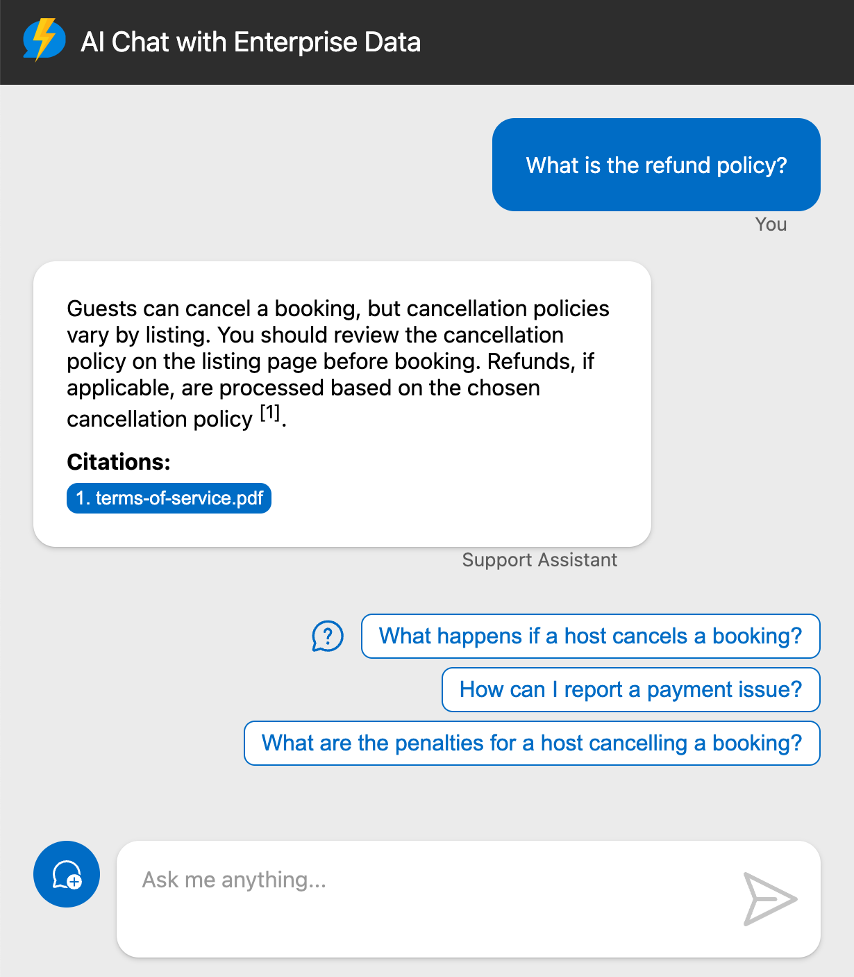
serverless-chat-langchainjs
Azure OpenAI +
Azure Cosmos DB +
Azure Functions + Azure Static Web Apps
Features:
Simple serverless backend (3 APIs)
Reusable and customizable UI
Develop fully locally with Ollama
Optional enterprise-level security
Code:
aka.ms/lcjs/chat

Slide 21
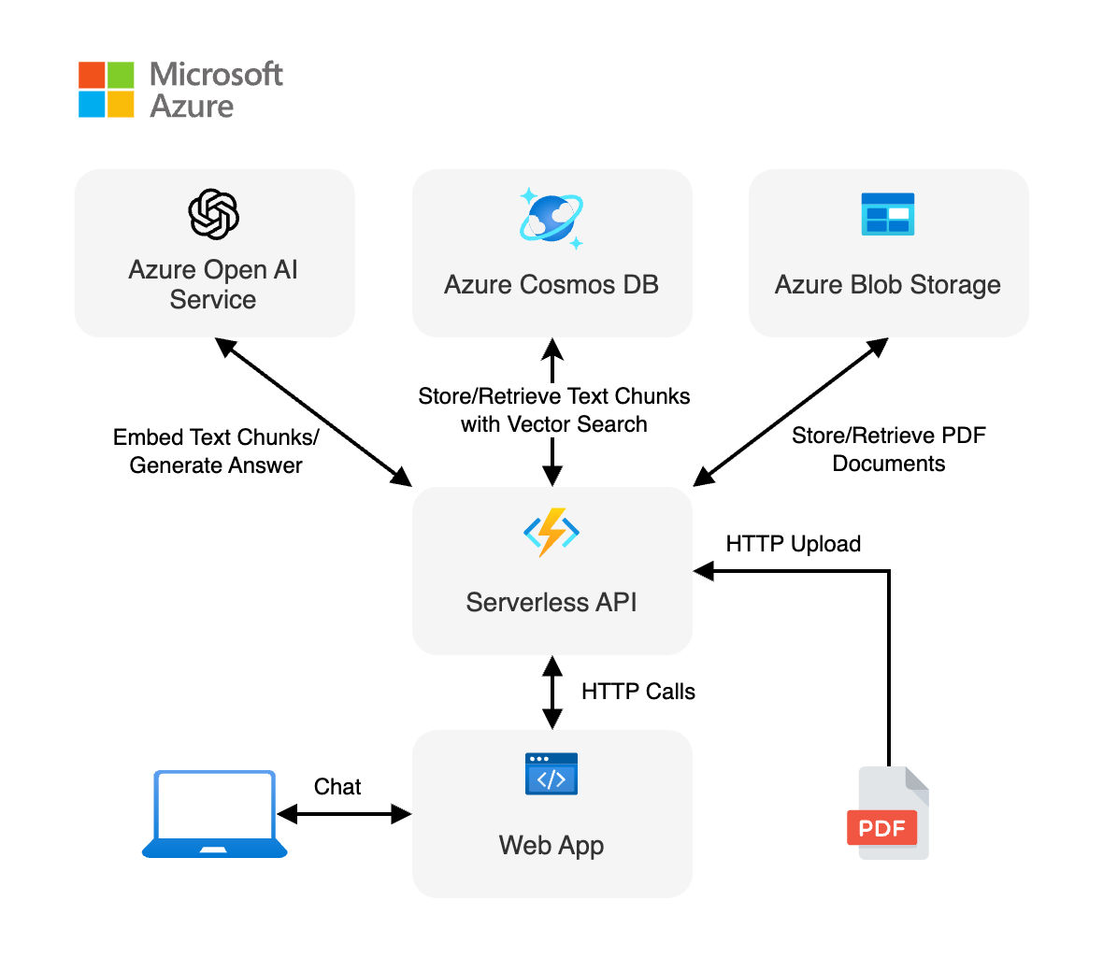
Architecture

Slide 22


Technical stack
Backend
Node.js
TypeScript
LangChain.js
Hosted on Azure Functions
Frontend
Lit web component
Vanilla HTML
Vite
Hosted on Azure Static Web Apps

Slide 23
Prerequisites for Azure deployment
Azure account and subscription
A free account can be used, but will have limitations.
Access to Azure OpenAI
Azure account permissions:
Microsoft.Authorization/roleAssignments/write
Microsoft.Resources/deployments/write on subscription level
https://github.com/Azure-Samples/serverless-chat-langchainjs/#azure-prerequisites

Slide 24
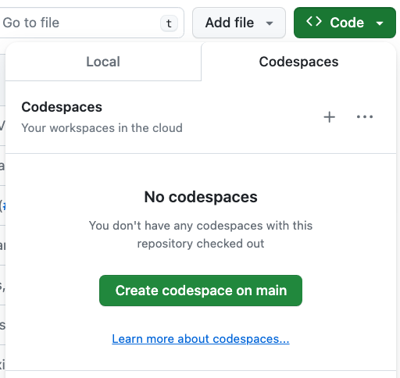
Opening the project: 3 options
GitHub Codespaces →
VS Code with Dev Containers extension
Your Local Environment
Node.js 20+
Azure Developer CLI
(Optional) Ollama
https://github.com/Azure-Samples/serverless-chat-langchainjs/#getting-started

Slide 25
Deploying with the Azure Developer CLI
Login to your Azure account:
azd auth login --use-device-code
Create a new azd environment:
azd env new
Provision resources and deploy app:
azd up
💸 Deploys by default using free tiers!

Slide 26

Code walkthrough
Typescript frontend
(Lit Web Component)
Node.js backend
(Azure Functions, TypeScript)
chat.ts
getCompletion()
POST /api/chat/stream
chat-post.ts
api.ts
chatApi()
POST /api/documents
documents-post.ts
@microsoft/ai-chat-protocol
GET /api/documents/{file}
documents-get.ts

Slide 27

Starting the local server
npm start
Starts Azure Functions emulator (backend API)
Starts a Vite dev server for the frontend with local API proxy
Both reloads automatically when you modify the code
localhost:7071
localhost:8000

Slide 28
RAGHack: RAG-focused hackathon
aka.ms/RAGhack
Week 1: September 3 - 8
9
MONDAY
3
TUESDAY
4
WEDNESDAY
5
THURSDAY
6
FRIDAY
7
SATURDAY
8
SUNDAY
RAG 101
.NET
Azure AI Studio
Python
Langchain4J
LangchainJS
Responsible AI
MongoDB
Azure AI Search
PostgreSQL
Azure SQL
GraphRAG
Multi-channels
Hack!
Hack!
Hack!
Hack!
Hack!
Hack!
Week 2: September 9 - 14
9
MONDAY
10
TUESDAY
11
WEDNESDAY
12
THURSDAY
13
FRIDAY
14
SATURDAY
15
SUNDAY
Semantic Kernel
Spring AI
Vision models
Internationalization
VSCode Agent
Agentic RAG
Code Interpreter
AI Studio Advanced
AutoGen
Data Access Control
Fine Tuning
Model catalog
Evaluations
Hack!
Hack!
Hack!
Hack!
Hack!
Hack!
Hack!
Hack!
Hack!
Submissions due September 16, 11:59 PM PT!

Slide 29
Resources
Serverless AI chat demo
Implement RAG training
AI chat with RAG workshop
aka.ms/ai/js/chat
aka.ms/genai/rag
aka.ms/ws/openai-rag-qdrant

